Slide 1
The implications of epithelial activation across the upper and lower airway
Professor Eugenio De Corso
Agostino Gemelli University Policlinic, Rome, Italy
EAACI Congress 2025
Veeva ID: GB-73341; date of preparation: February 2026. © 2026 AstraZeneca. All Rights Reserved. This information is intended for healthcare professionals only. EpiCentral is sponsored and developed by AstraZeneca.

Slide 2
The co-occurrence of upper and lower airway diseases is known as ‘united airways disease’^{1–3}
Upper respiratory tract⁴
Upper airway diseases (eg chronic rhinosinusitis, rhinitis)
Nasal cavity
Pharynx
Larynx
United airways disease
Trachea
Lower respiratory tract^{4,5}
Lower airway diseases (eg asthma)
Bronchi
Bronchioles
Alveoli
Figure adapted from Laulajainen-Hongisto A, et al. Front Cell Dev Biol 2020;8:204, Adivitiya, et al. Biology (Basel) 2021;10:95 and Baldassi D, et al. Adv Nanobiomed Res 2021;1:2000111^{6–8}
1. Jakwerth CA, et al. Cells 2022;11:1387; 2. Kicic A, et al. J Allergy Clin Immunol 2020;145:1562–1573; 3. Yii ACA, et al. Allergy 2018;73:1964–1978; 4. Ball M, et al. Anatomy, airway. In: StatPearls [Internet]. Treasure Island, FL, USA: StatPearls Publishing, 2023; 5. Hewitt RJ, Lloyd CM. Nat Rev Immunol 2021;21:347–362; 6. Laulajainen-Hongisto A, et al. Front Cell Dev Biol 2020;8:204; 7. Adivitiya, et al. Biology (Basel) 2021;10:95; 8. Baldassi D, et al. Adv Nanobiomed Res 2021;1:2000111

Slide 3
Epithelial-driven diseases of the airway frequently co-occur
Upper airways
Lower airways
CRSwNP
Allergic rhinitis
Asthma
Up to
49%
5–56%
>60%
≥10%
8–21%
of patients with severe asthma have a history of nasal or sinus polyps^{4,5}
of patients have asthma^{1*}
of patients have asthma²
of patients have allergic rhinitis³
of patients have chronic sinusitis^{3†}
Patients diagnosed with CRSwNP and asthma have a greater burden of disease than those without asthma^{6–8}
Asthma in the presence of allergic rhinitis is more difficult to control⁹
Asthma in the presence of nasal polyps is more difficult to control⁶
*Data were collected as part of a systemic literature review of the epidemiology and clinical burden of CRSwNP. Embase, MEDLINE, and Evidence-Based Medicine Reviews databases were searched using OVID. For epidemiology and clinical burden, 147 and 119 records, respectively, were included^{1; †}The prevalence of CRS in patients with asthma varies according to disease severity¹⁰ CRS, chronic rhinosinusitis; CRSwNP, chronic rhinosinusitis with nasal polyps
1. Chen S, et al. Curr Med Res Opin 2020;36:1897–1911; 2. Valero A, et al. J Investig Allergol Clin Immunol 2009;19:167–172; 3. Nunes C, et al. Asthma Res Pract 2017;3:1; 4. Reddel HK, et al. Eur Respir J 2021;58:2003927; 5. Scelo G, et al. Ann Allergy Asthma Immunol 2024;132:42–53; 6. Laidlaw TM, et al. J Allergy Clin Immunol Pract 2021;9:1133–1141; 7. Bachert C, et al. J Asthma Allergy 2021;14:127–134; 8. Toppila-Salmi S, et al. Clin Transl Allergy 2022;12:e12200; 9. Al-Hadrawi Z, et al. Eur Clin Respir J 2024;11:2397174; 10. Seccia V, et al. J Pers Med 2022;12:1096

Slide 4

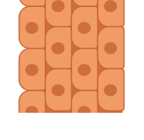

The epithelium forms a continuous link across the upper and lower airway, acting as the first line of defence from environmental insults^{1,2}
Nasal cavity
Upper airway³
Sinuses
Stratified squamous epithelium⁵
Nasal cavity
Pharynx
Larynx
Upper to lower airway transition
Trachea
Pseudostratified columnar ciliated epithelium^{4–6}
Lower airway^{3,4}
Bronchi
Bronchioles and alveoli
Bronchioles
Alveoli
Cuboidal / simple squamous epithelium^{5–7}
The upper and lower airway epithelium is a physical barrier, environmental sensor and an immune-functioning organ, orchestrating overlapping innate and adaptive immune responses against multiple environmental triggers^{1,8}
Beyond structural aspects, the upper and lower airways share many physiological and immunological features⁹
Figure adapted from Laulajainen-Hongisto A, et al. Front Cell Dev Biol 2020;8:204, Adivitiya, et al. Biology (Basel) 2021;10:95 and Baldassi D, et al. Adv Nanobiomed Res 2021;1:2000111^{5,6,10}
1. Fokkens W, Reitsma S. Otolaryngol Clin North Am 2023;56:1–10; 2. Bartemes KR, Kita H. Clin Immunol 2012;143:222–235; 3. Ball M, et al. Anatomy, airway. In: StatPearls [Internet]. Treasure Island, FL, USA: StatPearls Publishing, 2023; 4. Hewitt RJ, Lloyd CM. Nat Rev Immunol 2021;21:347–362; 5. Adivitiya, et al. Biology (Basel) 2021;10:95; 6. Laulajainen-Hongisto A, et al. Front Cell Dev Biol 2020;8:204; 7. Jakwerth CA, et al. Cells 2022;11:1387; 8. Roan F, et al. J Clin Invest 2019;129:1441–1451; 9. Cho H-J, et al. Rhinology 2021;59:441–450; 10. Baldassi D, et al. Adv Nanobiomed Res 2021;1:2000111

Slide 5
Impaired epithelial health drives the pathology and clinical manifestations of upper airway diseases^{1–9}
Upper airway diseases: CRSwNP and allergic rhinitis
Mucus
DC
Smoke/ pollutants
Neutrophil
Disease pathology
Shared: chronic inflammation and remodelling^{2,8,10}
CRSwNP-specific: nasal polyp formation²
Allergic rhinitis-specific: tissue oedema¹⁰
DC
ILC1
Mast cell
Viruses
IgE
TSLP/ IL-25/ IL-33
Eos
Insults
Clinical manifestations
Shared: nasal symptoms including rhinorrhoea and nasal blockage/congestion^{2,8}
CRSwNP-specific: exacerbations, a reduction or loss of sense of smell and need for surgery²
Allergic rhinitis-specific: red/itchy eyes and nasal itch⁸
Allergens
ILC2
Mast cells
Fungi
TSLP
Macrophage
Bacteria
TSLP/ IL-33
DC
Neutrophil
Information presented in this image has been simplified for illustration purposes only. Figure adapted from Caminati M, et al. Allergy 2024;79:1134–1145
CRSwNP, chronic rhinosinusitis with nasal polyps; DC, dendritic cell; Eos, eosinophil(s); IgE, immunoglobulin E; IL, interleukin; ILC, innate lymphoid cell; TSLP, thymic stromal lymphopoietin
1. Calderon AA, et al. Eur Respir Rev 2023;32:220144; 2. Fokkens WJ, et al. Rhinology 2020;58(Suppl. S29):1–464; 3. Staudacher AG, et al. Ann Allergy Asthma Immunol 2020;124:318–325; 4. Caminati M, et al. Allergy 2024;79:1134–1145; 5. Yii ACA, et al. Allergy 2018;73:1964–1978; 6. Fokkens W, Reitsma S. Otolaryngol Clin North Am 2023;56:1–10; 7. Brightling C, Greening N. Eur Respir J 2019;54:1900651; 8. Bousquet J, et al. Nat Rev Dis Primers 2020;6:95; 9. Hellings PW, et al. J Allergy Clin Immunol 2020;145:1499–1509; 10. Bjermer L, et al. Allergy Asthma Clin Immunol 2019;15:24

Slide 6
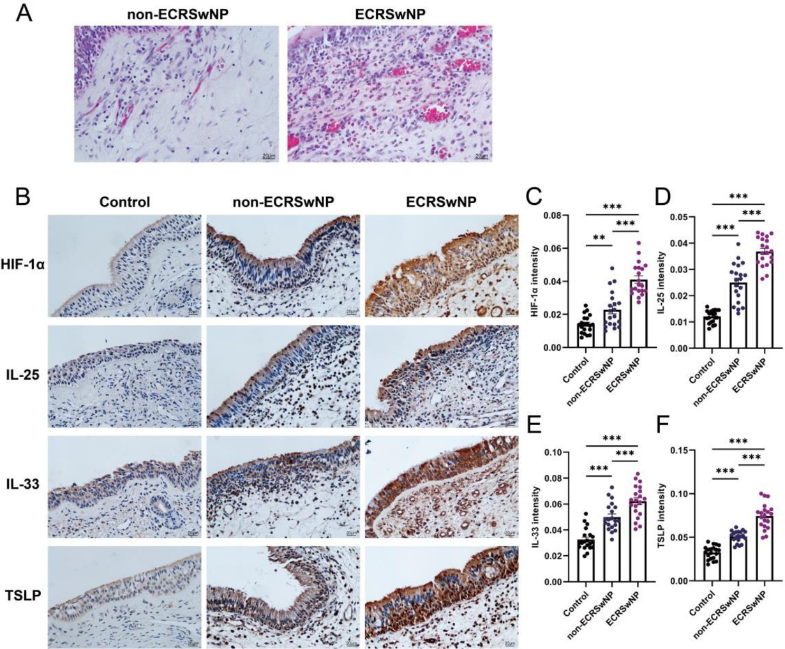

Epithelial cytokine expression is increased in eosinophilic and non‑eosinophilic CRSwNP
Nasal mucosal epithelial tissue shows an increase in levels of TSLP, IL‑25 and IL‑33 in patients with non‑eCRSwNP and eCRSwNP compared with controls, with the highest levels observed in the eCRSwNP group¹
***
***
***
Non-eosinophilic CRSwNP
Eosinophilic CRSwNP
***
***
***
Control
0.15
***
0.10
***
0.05
***
TSLP
0.08
0.04
0.10
0.06
0.03
TSLP intensity
IL‑33 intensity
IL‑25 intensity
IL-25
0.05
0.04
0.02
0.02
0.01
IL-33
0.00
0.00
0.00
Cells expressing labelled cytokines (TSLP, IL-25 or IL-33) stain brown
Control (n=20)
Non‑eCRSwNP (n=20)
eCRSwNP (n=20)
Eosinophilic CRSwNP was defined as the proportion of eosinophils in the nasal polyp tissue accounting for >10% of the total number of infiltrating cells; otherwise, it was defined as
non-eosinophilic CRSwNP
Figures from Zhang M, et al. Int Immunopharmacol 2023;121:110559. Values represent the mean ± SEM; ***P<0.001 CRS, chronic rhinosinusitis; CRSwNP, CRS with nasal polyps; eCRSwNP, eosinophilic CRSwNP; IL, interleukin; SEM, standard error of the mean; TSLP, thymic stromal lymphopoietin 1. Zhang M, et al. Int Immunopharmacol 2023;121:110559

Slide 7


TSLP, TSLP receptor and IL-33 receptor expressions correlate with CRSwNP severity^{1,2}
Levels of TSLP, TSLP receptor and IL-33 receptor mRNA expression in nasal polyp tissue and nasal epithelial cells were associated with:
CRSwNP symptoms*
Sinus opacification†
IL-5 and IL-13 expression
Eosinophils
Among patients with eosinophilic CRSwNP
Among patients with nasal pathology‡
Disease severity
Inflammation in local tissue
*Subjective symptoms were scored on a VAS of 0 to 10;¹ †CT scans were graded using the Lund-Mackay CT scoring system;¹ ‡patients with eosinophilic or non-eosinophilic CRSwNP or patients with sinus cyst, nasal tumour or maxillofacial trauma without rhinitis or sinusitis¹
CRSwNP, chronic rhinosinusitis with nasal polyps; CT, computed tomography; IL, interleukin; mRNA, messenger RNA; TSLP, thymic stromal lymphopoietin; VAS, visual analogue scale
1. Liao B, et al. Allergy 2015;70:1169–1180; 2. Liao B, et al. Allergy 2015;70:1169–1180 (Supplementary Information)

Slide 8

TSLP may drive corticosteroid resistance in patients with AR and nasal polyps
Glucocorticoid receptor signalling
Correlation TSLP and GRβ expression in eosinophils or neutrophils in nasal mucosa
TSLP from nasal epithelial cells of patients with AR and NP who were corticosteroid resistant induced GRβ expression in eosinophils and neutrophils
GRβ competitively interferes with GRα-steroid binding; overexpression of GRβ is proposed as a potential mechanism underlying steroid resistance
Eosinophils and neutrophils derived from nasal tissue show elevated GRβ expression in corticosteroid-resistant AR with NP
0.75
4.0
5.0
GRβ mRNA in eosinophils (RQ)
GRβ mRNA in neutrophils (RQ)
3.5
4.0
3.0
3.0
2.5
r=0.5195
P=0.0189
2.0
r=0.5341
P=0.0153
2.0
1.0
n=51
2
3
4
1
2
3
4
1
5
5
TSLP mRNA in NECs
TSLP mRNA in NECs
AR, allergic rhinitis; GR, glucocorticoid receptor; mRNA, messenger RNA; NEC, nasal epithelial cell; NP, nasal polyps; RQ, relative quantification; TSLP, thymic stromal lymphopoietin
Xue J-M, et al. Int J Biol Sci 2021;17:2089–2098

Slide 9
Epithelial cytokine expression is increased in allergic rhinitis (1/3)
TSLP expression¹
TSLP mRNA expression²
TSLP expression was significantly increased in nasal mucosa of patients with allergic rhinitis versus healthy controls¹
TSLP mRNA was significantly increased in nasal mucosa of patients with mild allergic rhinitis and increased further in moderate-to-severe disease²*
Relative protein expression levels of TSLP†
0.6
6
P<0.05
Relative fold‡
5
P=0.002
0.4
4
P=0.047
3
0.2
2
1
0.0
0
Control
Allergic rhinitis
Control (n=11)
Mild allergic rhinitis (n=7)
Moderate/ severe allergic rhinitis (n=9)
Figures adapted from Chang W, et al. Mol Med Rep 2022;26:347. Licenced under CC BY-NC-ND 4.0 from: https://creativecommons.org/licenses/by-nc-nd/4.0/ (Accessed February 2026) and Mou Z, et al. Acta Otolaryngol 2009;129:297–301 *Severity defined using ARIA guidelines; †data are mean (n=6, 3 repeats) and error bars indicate SEM; ‡performed in duplicate
ARIA, Allergic Rhinitis and its Impact on Asthma; mRNA, messenger RNA; SEM, standard error of the mean; TSLP, thymic stromal lymphopoietin
1. Chang W, et al. Mol Med Rep 2022;26:347; 2. Mou Z, et al. Acta Otolaryngol 2009;129:297–301

Slide 10
Epithelial cytokine expression is increased in allergic rhinitis (2/3)
Mean serum IL-33 (pg/mL)
6000
5000
Serum IL-33 is significantly increased in patients with allergic rhinitis compared with controls
4000
3000
P<0.05
2000
1000
0
Control (n=38)
Allergic rhinitis (n=45)
TSLP mRNA in NECs
Figure adapted from Kamekura R, et al. Clin Exp Allergy 2012;42:218–228 IL, interleukin; mRNA, messenger RNA; NEC, nasal epithelial cell; TSLP, thymic stromal lymphopoietin
Kamekura R, et al. Clin Exp Allergy 2012;42:218–228

Slide 11
Epithelial cytokine expression is increased in allergic rhinitis (3/3)
Relative IL-25 mRNA expression
150
0.75
P<0.0001
IL-25 mRNA expression is significantly increased in nasal mucosa of patients with allergic rhinitis versus healthy controls
100
50
0
Control (n=8)
Allergic rhinitis (n=14)
Figure adapted from Kim DW, et al. Mediators Inflamm 2017;2017:3908049. Licenced under CC BY 4.0 from: https://creativecommons.org/licenses/by/4.0/ (Accessed February 2026) IL, interleukin; mRNA, messenger RNA
Kim DW, et al. Mediators Inflamm 2017;2017:3908049

Slide 12



Summary
The epithelium forms a continuous link across the upper and lower airway¹ and acts as the critical gateway for initiation and amplification of inflammatory responses in epithelial-driven diseases^{2,3}
Upper and lower airways diseases have heterogeneous and overlapping inflammatory pathways, driven by epithelial cytokines^{1,4,5–10}
Epithelial cytokines are elevated in CRSwNP and allergic rhinitis^{11–15}
Disruption of epithelial health is central to the pathogenesis of epithelial-driven diseases, which occur throughout the airway^{5,16–18}
CRSwNP, chronic rhinosinusitis with nasal polyps 1. Fokkens W, Reitsma S. Otolaryngol Clin North Am 2023;56:1–10; 2. Bartemes KR, Kita H. Clin Immunol 2012;143:222–235; 3. Raby KL, et al. Front Immunol 2023;14:1201658; 4. Yii ACA, et al. Allergy 2018;73:1964–1978; 5. Hellings PW, Steelant B. J Allergy Clin Immunol 2020;145:1499–1509; 6. Bousquet J, et al. Nat Rev Dis Primers 2020;6:95; 7. Fokkens WJ, et al. Rhinology 2020;58(Suppl. S29):1–464; 8. Staudacher AG, et al. Ann Allergy Asthma Immunol 2020;124:318–325; 9. Caminati M, et al. Allergy 2024;79:1134–1145; 10. Calderon AA, et al. Eur Respir Rev 2023;32:220144; 11. Zhang M, et al. Int Immunopharmacol 2023;121:110559; 12. Liao B, et al. Allergy 2015;70:1169–1180; 13. Xu G, et al. Allergy 2010;65:581–589; 14. Mou Z, et al. Acta Otolaryngol 2009;129:297–301; 15. Kamekura R, et al. Clin Exp Allergy 2012;42:218–228; 16. Russell RJ, et al. Eur Respir J 2024;63:2301397; 17. Ha J-G, Cho H-J. Int J Mol Sci 2023;24:14229; 18. Porsbjerg C, et al. Lancet 2023;401:858–873

